Slide 1

C-Suite Presentation Room 3

Slide 2

The purpose of this report is to provide a comprehensive analysis of Sales data for the C-suite to support strategic decision-making. The report focuses on identifying key trends, patterns, and insights within the sales data to highlight areas of strength and opportunities for improvement.The scope of this analysis includes examining sales performance across different products, regions, and time periods, as well as evaluating customer behavior and market dynamics. This analysis aims to enable the leadership team to make data-driven decisions that drive revenue growth and optimize business operations.

Slide 3
The objectives of this report are:
To identify high-performing products and regions contributing to revenue.
To pinpoint underperforming areas and recommend improvement strategies.
To forecast future sales trends based on historical data.
To provide actionable insights to enhance overall business performance.

Slide 4
Introduction

Slide 5
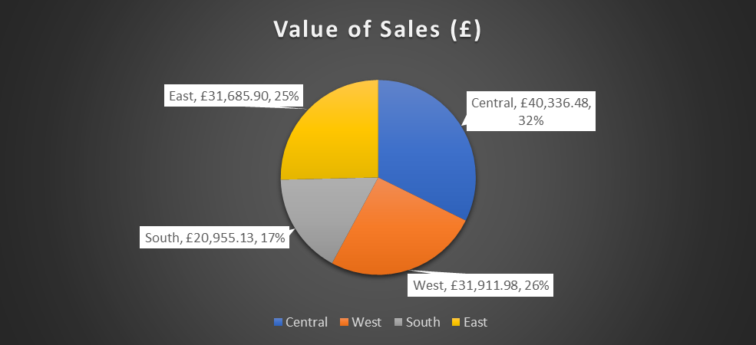
Value of Sales by Region

Slide 6
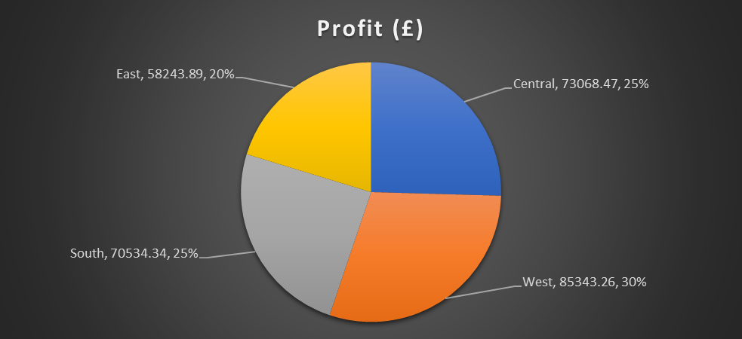
Profits by Region
Notes:
The bar chart highlights monthly revenue trends over the analyzed period. Average monthly revenue growth is approximately 19.30%. Peaks in revenue correspond to seasonal spikes, which could be leveraged for targeted marketing. Opportunities lie in stabilizing dips through better forecasting and resource allocation.

Slide 7
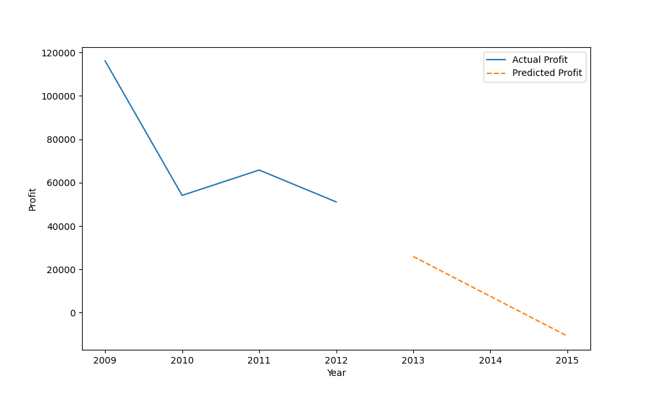
Profit by Year

Slide 8
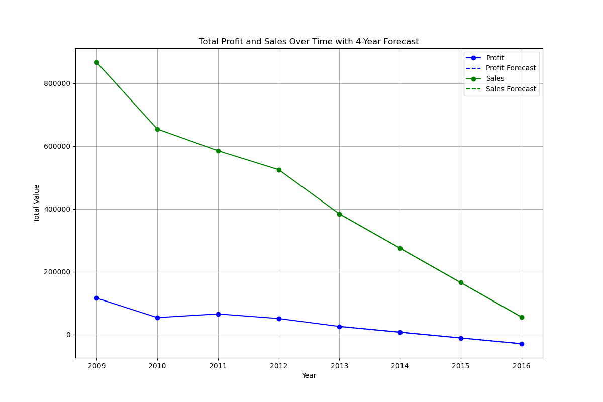
Annual Sales and Profit

Slide 9
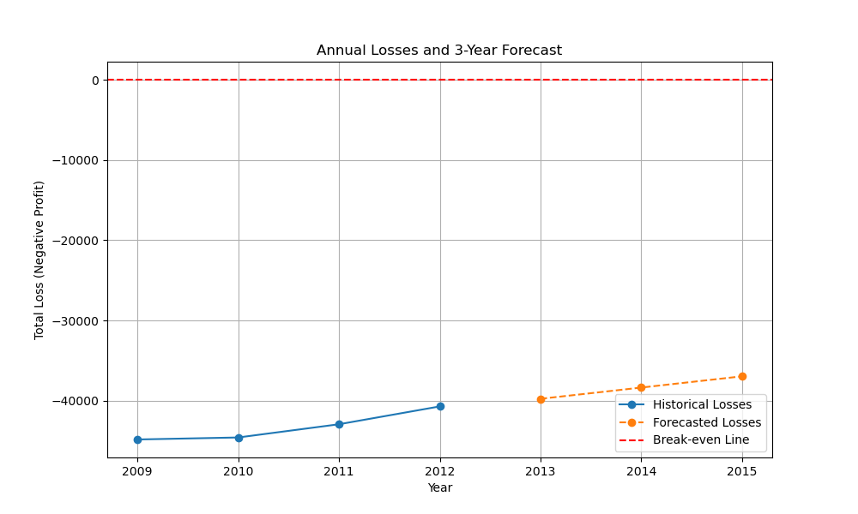
Yearly Loss Making Sales

Slide 10
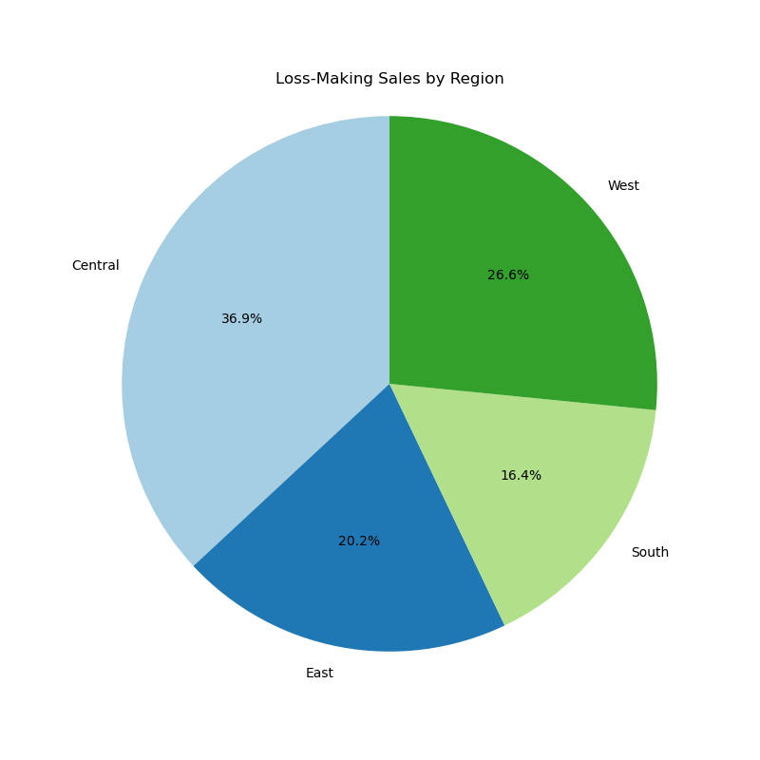
Loss Making Sales by Region

Slide 11
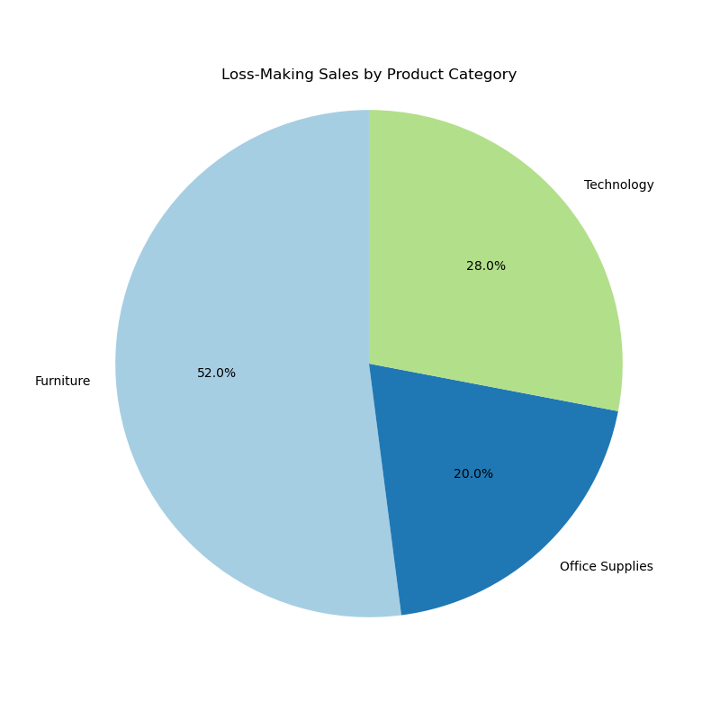
Loss making sales by category

Slide 12
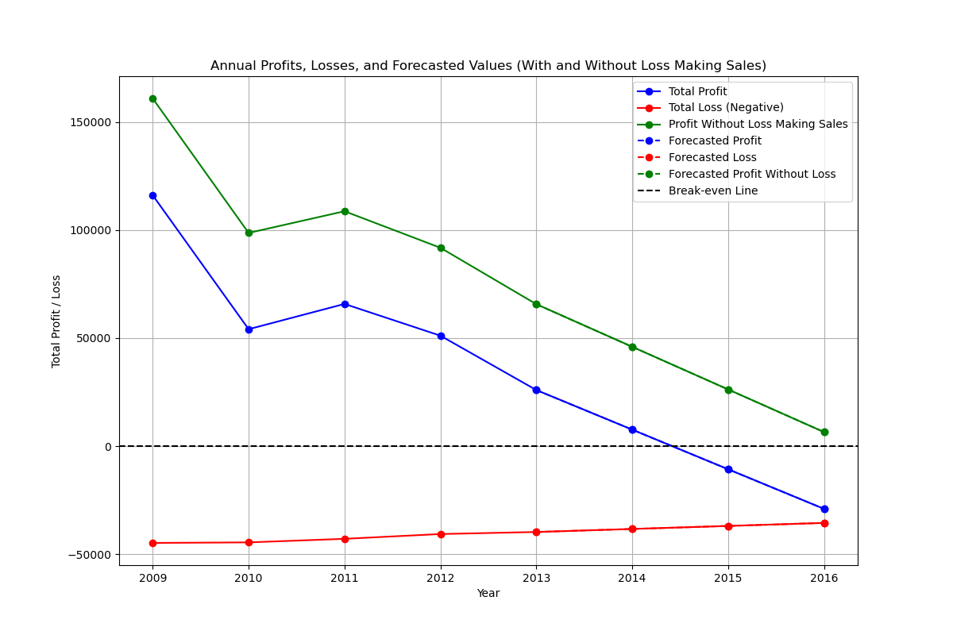
Predicted Profits without loss-making sales

Slide 13
1. Focus on High-Performing Areas. Prioritize resources for top-performing products and regions. Launch targeted marketing campaigns to sustain growth. 2. Address Underperformance Identify reasons for low sales in certain areas. Revise strategies or discontinue unprofitable products. 3. Enhance customer retention through the implementation of loyalty programs and personalized marketing. Use feedback to improve offerings and satisfaction. 4. Optimize Sales Processes Invest in CRM tools and sales automation. Train sales teams for better productivity. 5. Explore New Markets and Research opportunities in untapped regions. Assess demand and competition before expansion. 6. Leverage Predictive Analytics. Use historical data to forecast trends. Adopt machine learning to identify growth opportunities. 7. Monitor Performance KPIs. Define and track clear sales KPIs. Use dashboards for real-time decision-making. These recommendations align sales strategies with business goals to ensure growth and operational efficiency.
Recommendations for Sales Data Insights

